Slide 1
JAVA FULL STACK MINI PROJECT DAILY QUOTES JOURNAL DONE BY: KAVYA DARSHINI S 43230019 B.Tech Biotechnology

Slide 2
Abstract
Web app for viewing, storing, and generating motivational quotes
Users can add, favorite, and generate daily quotes
Uses Spring Boot backend & MySQL database
Demonstrates CRUD, API integration, interactive UI

Slide 3
Existing System
Static quote display on existing websites/apps
No personal quote storage or favorites
No dynamic daily/random quote generation from user data
Limited interactivity and customization

Slide 4
Proposed System
Personalized quote addition and management
Dynamic “Quote of the Day” generation
Secure REST API backend with Spring Boot
User-friendly frontend with HTML, CSS, JavaScript

Slide 5
Advantages
Interactive and dynamic application
Easy, visually simple design
Permanent quote storage in database
Scalable for future features (login, themes)

Slide 6
Disadvantages
Currently local access only, no deployment
No user authentication yet
Internet needed if backend is remote
No support for image or media quotes

Slide 7
Hardware Requirements
Intel i3 or higher processor
Minimum 4 GB RAM
500 MB free storage
Windows/macOS/Linux OS, 1024x768+ screen resolution

Slide 8
Software Requirements
IDE: Visual Studio Code
Backend: Spring Boot (Java)
Build tool: Maven
Database: MySQL
Browser: Chrome/Edge
JDK 21+

Slide 9
Modules
Add Quote: user inputs new quotes
View Quotes: display all quotes in table
Random Quote: show a random quote daily
Favorite Quote: mark and view favorite quotes
Backend: CRUD operations via REST APIs

Slide 10
Module Description
Add Quote: store user input via backend
Display Quotes: fetch and show quotes
Random Quote: select “Quote of the Day” randomly
Favorite Handling: update favorite status in database
Data Persistence: MySQL efficient storage

Slide 11
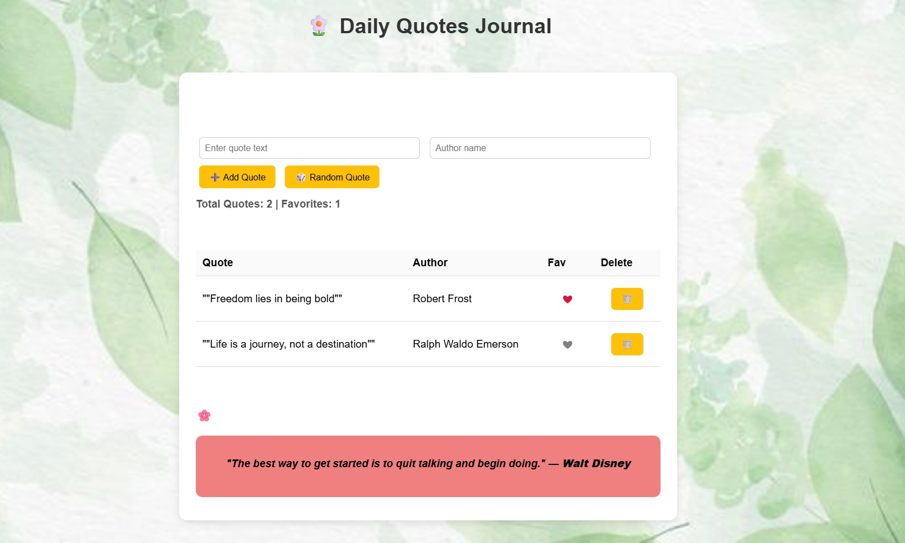
SAMPLE OUTPUT

Slide 12

Conclusion
Full-stack app demonstrating frontend, backend, database integration
Motivates users through daily quotes
Shows skills in Spring Boot, MySQL, JavaScript
Future: user login, categories, cloud deployment

